Slide 1


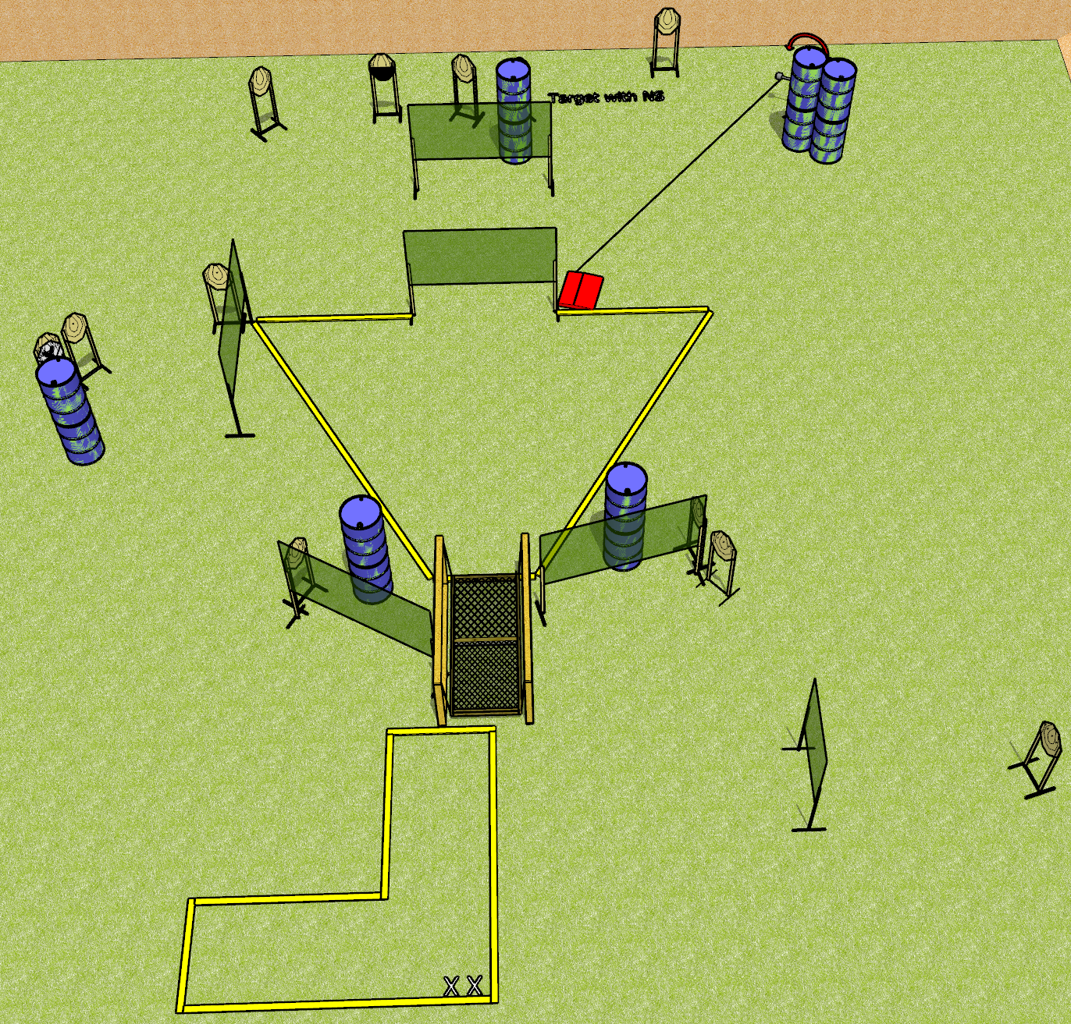
 | Dothan Gun Club – USPSA Match Suck it up Buttercup Course Designer : Drew Coleman
Round Count 26 rounds 13 IPSC
Equipment List 12 wall feet Bridge Swinger + stomp pad 1 50%, 14 paper (12 + 2 NS)

Slide 2
Suck it up Buttercup
Written Stage Briefing
Suck it up Buttercup is a 26 round, 130-point, Comstock course of fire. There are 13 IPSC targets. The best 2 hits will score.
Handgun start position is heels on X’s, wrists below belt. Handgun is loaded and holstered.
PCC start position is heels on X’s, stock on belt. Loaded carbine is held with both hands, safety on.
On the audible start signal, engage targets as they become available from within the shooting area.
The bridge supports, railing, chains, and frame are NOT part of the shooting area.

